Slide 1

Med-Fi Prototyping
Niki A, Safiyah L, Roy Y, Raymond G
Notes:
Prototype: https://www.figma.com/proto/wrQpsVX7whXSX19XgMReNB/med-fi?node-id=28%3A319&scaling=scale-down&page-id=0%3A1&starting-point-node-id=28%3A291&show-proto-sidebar=1

Slide 2
Mission Statement
& Value Proposition
Our Mission: Enable people to connect with and inspire one another through collective, location-based audio journaling.
Value Proposition: Audio spaces that connect and inspire.
Notes:
SoundPrints mission is to enable people to connect with and inspire one another through collective, location-based audio journaling. More simply, our value proposition is: Audio spaces that connect and inspire.

Slide 3
Problem and Solution Overview
SoundPrints is a location-based audio journaling app that enables its users to connect with and inspire one another in the face of daunting obstacles that people often encounter as they try to achieve their goals. We hope users will be inspired by listening to the motivational recordings left by others at the places they visit, and that they will celebrate their successes by making their own recordings. We hope users will share their audio recordings with others in their community to inspire others to follow in their “soundprints.”
Notes:
SoundPrints is a location-based audio journaling app that enables its users to connect with and inspire one another in the face of daunting obstacles that people often encounter as they try to achieve their goals. We hope users will be inspired by listening to the motivational recordings left by others at the places they visit, and that they will celebrate their successes by making their own recordings. We hope users will share their audio recordings with others in their community to inspire others to follow in their “soundprints.”

Slide 4
Values Encoded
Inclusion: Ensuring all users feel connected, safe, and included in the SoundPrints community.
Giving and Receiving Motivation: Enable users to motivate one another to achieve their goals.
Privacy: Enabling users to have privacy while still enjoying the benefits of the app.
Notes:
SoundPrints mission is to enable people to connect with and inspire one another through collective, location-based audio journaling. More simply, our value proposition is: Audio spaces that connect and inspire.

Slide 5
Values Encoded: Inclusion
Inclusion: Connecting users and creating community
Users can listen to the recordings left by others
Users can leave their own audio recordings that will inspire others
Users can chat with and share audio recordings with their friends
Notes:
SoundPrints mission is to enable people to connect with and inspire one another through collective, location-based audio journaling. More simply, our value proposition is: Audio spaces that connect and inspire.

Slide 6
Values Encoded: Inclusion
Inclusion: Ensuring users are protected from psychological harm, including negative speech and insults. This can conflict with connecting users and creating community.
We only allow users to Chat with users who are in their Contacts (like Whatsapp) to avoid potentially uncomfortable contact with strangers
However, the recordings left by others could still cause psychological harm to users.
Features that could help but that we did not have time to include in our Medium Fidelity prototype:
  Community guidelines: Each user reads and signs community guidelines form. Pledge to be respectful towards and supportive of others in the community.
  “Report a recording” and “report a user” features: Allow users to report those who make them feel unsafe. Users will be banned from the app if they don’t follow the community guidelines.
  Run a hate speech detector on each recording.
Notes:
SoundPrints mission is to enable people to connect with and inspire one another through collective, location-based audio journaling. More simply, our value proposition is: Audio spaces that connect and inspire.

Slide 7
Values Encoded: Giving and Receiving Motivation
Giving and Receiving Motivation: Enable users to motivate one another to achieve their goals.
Users can listen to motivational audio recordings left by others near the location they are in. This creates an immersive experience for users to listen to motivation recordings related to the activities they are engaging in.
Users can make their own recordings to inspire the next person who visits that location.
Users can share their recordings and chat with their friends on the app, providing personalized support, accountability, and validation.
Notes:
SoundPrints mission is to enable people to connect with and inspire one another through collective, location-based audio journaling. More simply, our value proposition is: Audio spaces that connect and inspire.

Slide 8
Values Encoded: Privacy
Privacy: Enable users to preserve their privacy while still enjoying the features of the app.
We allow users to post recordings Anonymously in case they want to preserve their privacy while still enjoying the recording feature
We only allow users to Chat with users who are in their Contacts (like Whatsapp) to better protect their privacy from strangers
Notes:
SoundPrints mission is to enable people to connect with and inspire one another through collective, location-based audio journaling. More simply, our value proposition is: Audio spaces that connect and inspire.

Slide 9
Tasks
Simple: Listen to recordings made by others near your location.
Subtask 1: Listen to recordings made within 500 feet of your current location until the playlist resets.
Subtask 2: Listen to the recording “My Fave Spots.”
Moderate: Add your own recording to the set of recordings made near your location.
Complex: Share an audio recording that you made with a friend.
Notes:
No change in tasks from our low fidelity prototype.
Listening to recordings made by others is our simple task, because this is the task that requires the lowest effort (plugging in headphones and listening). It is the first step to becoming inspired to achieving one goals. Once users achieve their goals, then we hope that they will make recordings and share those recordings with their friends.

Slide 10
Usability Goals &
Key Measurements
Robust: Minimal error rates
  Primary Metric: How often does the user complete the task without going down the wrong path
  Secondary Metric: How often does the user ask us questions due to confusion about what to do?
Pleasant: High user satisfaction
  Measure by understanding what users like, dislike, find confusing, or find frustrating by:
    Noting moments during prototype test when users appear to find an experience enjoyable or confusing.
    User feedback in follow-up questions after prototype test

Slide 11

Revised Interface Design

Slide 12

Major Design Change: Navigation Bar
Helps us achieve usability goal of creating a more pleasant user experience
Integrated all homepage buttons as a bottom navigation bar in all frames so that they can be quickly accessed from any other screen.
Removed home button from top right corner, instead only including it in the bottom navigation bar.
Rationale:
  Low fidelity prototype testers suggested that a bottom navigation bar would increase efficiency and make user experience more enjoyable
  Placing both the Back and Home buttons at the top of the page created extra confusion about the purpose of the Back button
  Following design patterns used by other successful apps

Slide 13
Listen SubTask 1
Listen to recordings made within 500 feet of your current location until the playlist resets.
Notes:
No change in tasks from our low fidelity prototype.
Listening to recordings made by others is our simple task, because this is the task that requires the lowest effort (plugging in headphones and listening). It is the first step to becoming inspired to achieving one goals. Once users achieve their goals, then we hope that they will make recordings and share those recordings with their friends.

Slide 14
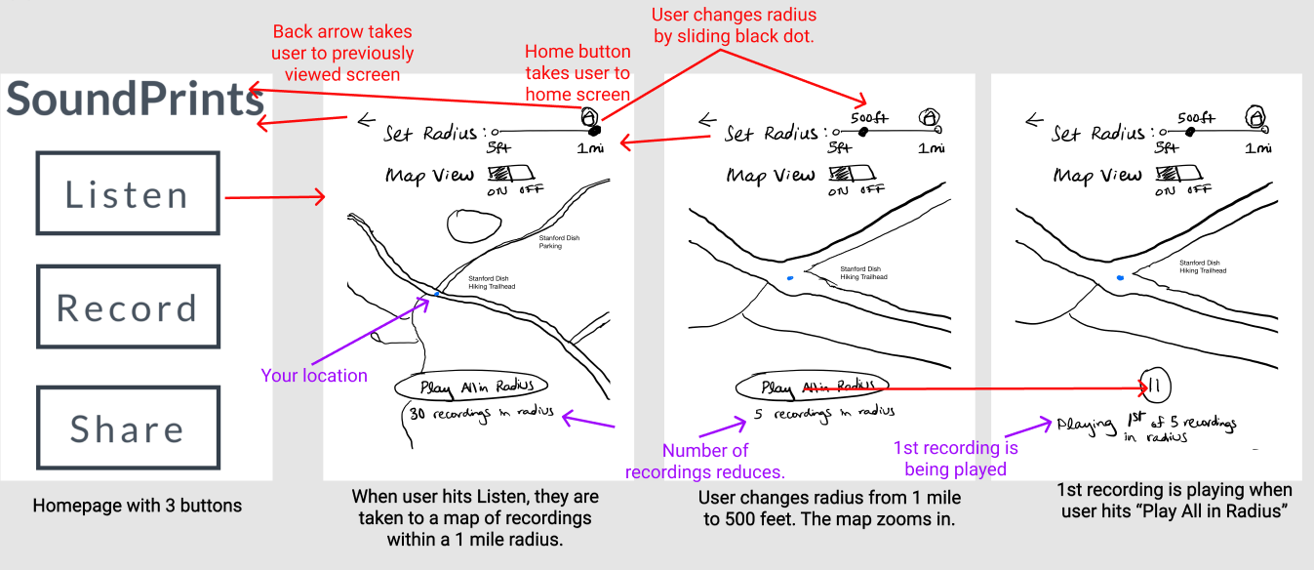
Listen Subtask 1: Before
For all listen slides,
Red arrows = taps
Purple arrows = annotation without click

Slide 15
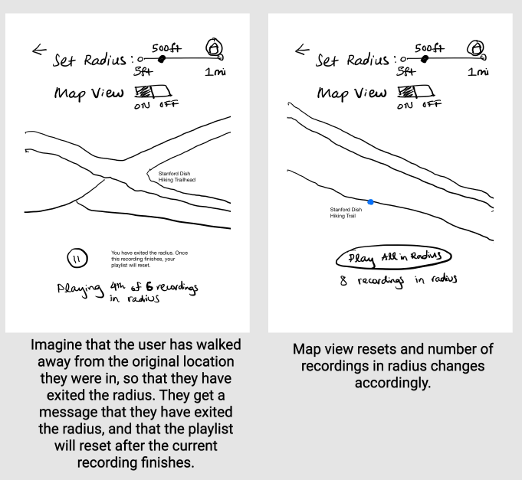
Listen Subtask 1: Before Continued

Slide 16
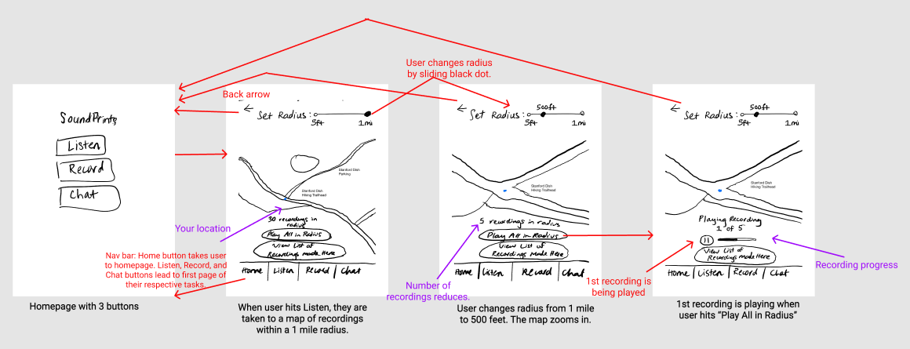
Listen Subtask 1: After

Slide 17
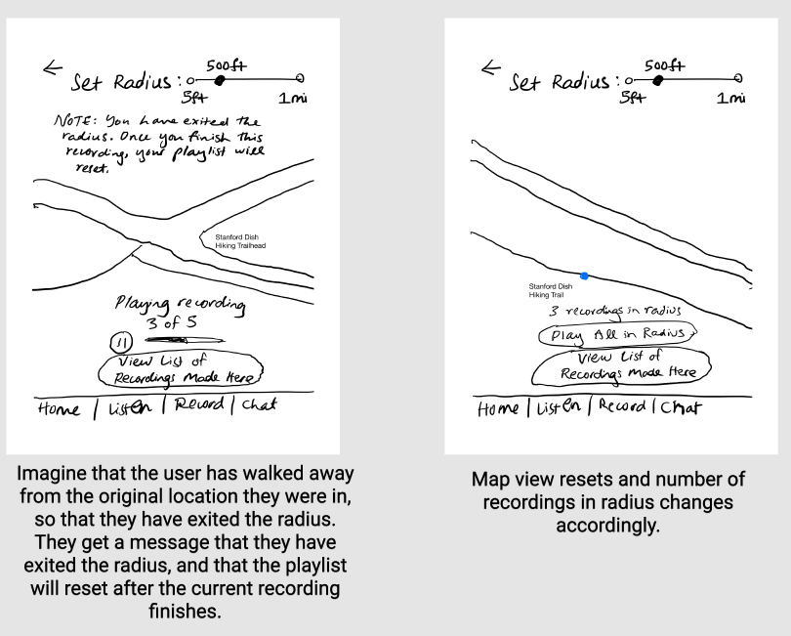
Listen Subtask 1: After Continued

Slide 18
Listen SubTask 2
Listen to the recording “My Fave Spots.”
Notes:
No change in tasks from our low fidelity prototype.
Listening to recordings made by others is our simple task, because this is the task that requires the lowest effort (plugging in headphones and listening). It is the first step to becoming inspired to achieving one goals. Once users achieve their goals, then we hope that they will make recordings and share those recordings with their friends.

Slide 19
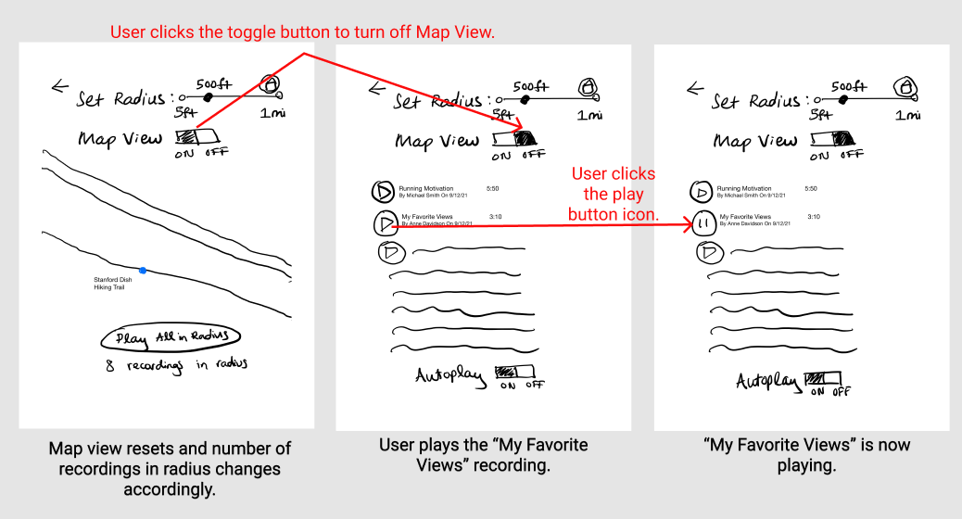
Listen Subtask 2: Before

Slide 20
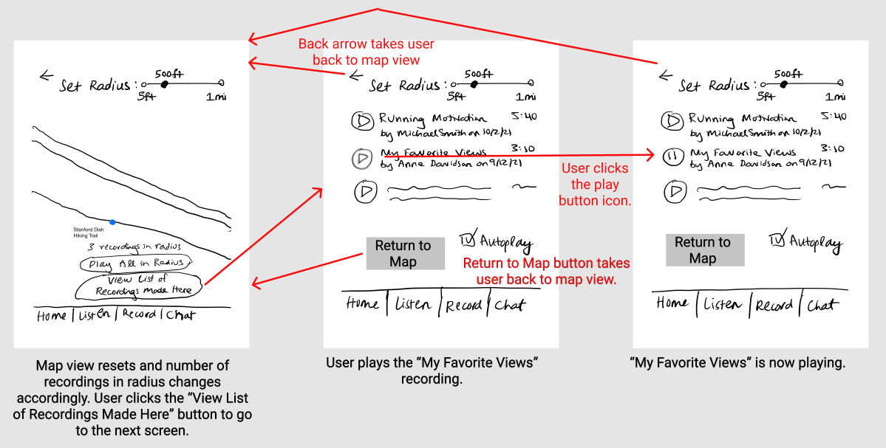
Listen Subtask 2: After

Slide 21
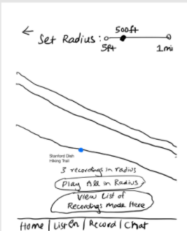
Major Design Changes: Listen Task
Map View: Removed the Map View On/Off toggle and replaced with “View List of Recordings Made Here” and “Return to Map” buttons
Buttons in a prominent location in order to call attention to them
Rationale:
Helps us achieve usability goal of making the app more robust
Users were all unable to perform Listen Subtask 2 without significant help from the facilitator
Notes:
More detailed explanation:
Map View: We removed the Map View On/Off toggle and replaced it with the “View List of Recordings Made Here” and “Return to Map” buttons. “View List of Recordings Made Here” button shows the users a list of recordings made near their location, allowing them to play individual recordings of their choice.
Rationale: In our usability testing, users found the Map View toggle unintuitive and were confused about its purpose. They were all unable to perform Listen Subtask 2 without significant help from the facilitator. This was one of our most severe errors. Once they understood the button’s purpose, they commented that it was a great feature to enable users to play recordings of their choice. We thought this new button more will more clearly communicate its purpose to users.
We place our new button in a prominent location, just below the “Play All in Radius” button in order to call attention to it.

Slide 22
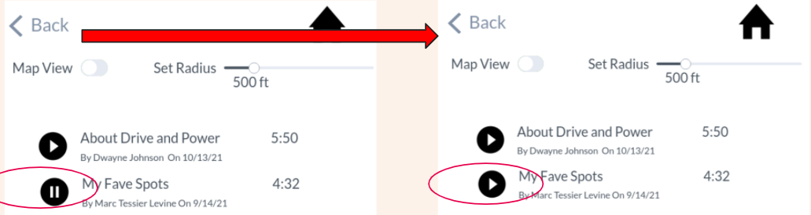
Major Design Changes: Listen Task
Back Button Consistency:
Previously, always linking the back button to the previously viewed screen caused confusion in the Listen task
Our changes improve robustness
Back button for all Listen task frames now either 1) links back to the home screen or 2) if the user has switched between Map and List view of the recordings, the back button takes the user to previous type of view
Return to Map button provides an additional way to go back to Map View in case users are still confused by the Back button.
Old use of back button, which caused confusion, especially when Pause turned into Play.
Notes:
More detailed explanation:
Back Button Consistency: In our low-fidelity prototype testing, users mentioned that always linking the back button to the previously viewed screen caused confusion in the Listen task, as this did not always make sense logically. For example, users were confused by the pause button turning back into play. Due to feedback from our CA, we decided not to remove the Back button. However, the Back button for all Listen task frames now either 1) links back to the home screen or 2) if the user has switched between Map and List view of the recordings, the back button takes the user to previous type of view. Return to Map button provides an additional way to go back to Map View in case users are still confused by the Back button.

Slide 23
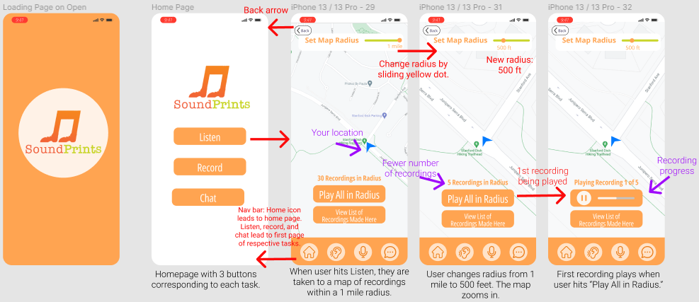
Listen Medium Fidelity: Subtask 1
All interactions are tap, except for “Set Map Radius,” which is drag.
All back arrows on this slide lead to home page.
Automatically goes into next screen

Slide 24
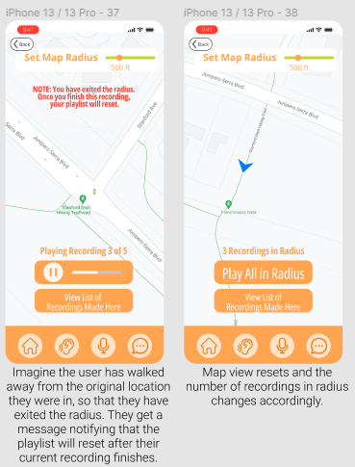
Listen Medium Fidelity: Subtask 1 Continued
All interactions are tap, except for “Set Map Radius,” which is drag.
All back arrows on this slide lead to home page.

Slide 25
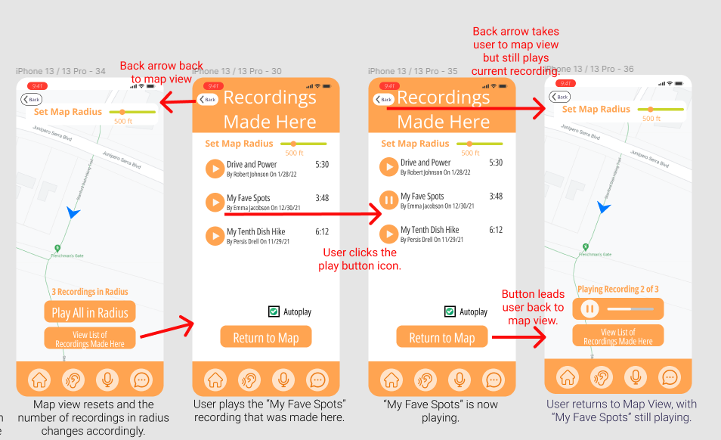
Listen Medium Fidelity: Subtask 2
All interactions are tap, except for “Set Map Radius,” which is drag. When user switches to “Recordings Made Here” screen (List View), both the Back and Return to Map buttons go back to Map.

Slide 26
Record
Add your own recording to the set of recordings made near your location.
Notes:
No change in tasks from our low fidelity prototype.
Listening to recordings made by others is our simple task, because this is the task that requires the lowest effort (plugging in headphones and listening). It is the first step to becoming inspired to achieving one goals. Once users achieve their goals, then we hope that they will make recordings and share those recordings with their friends.

Slide 27
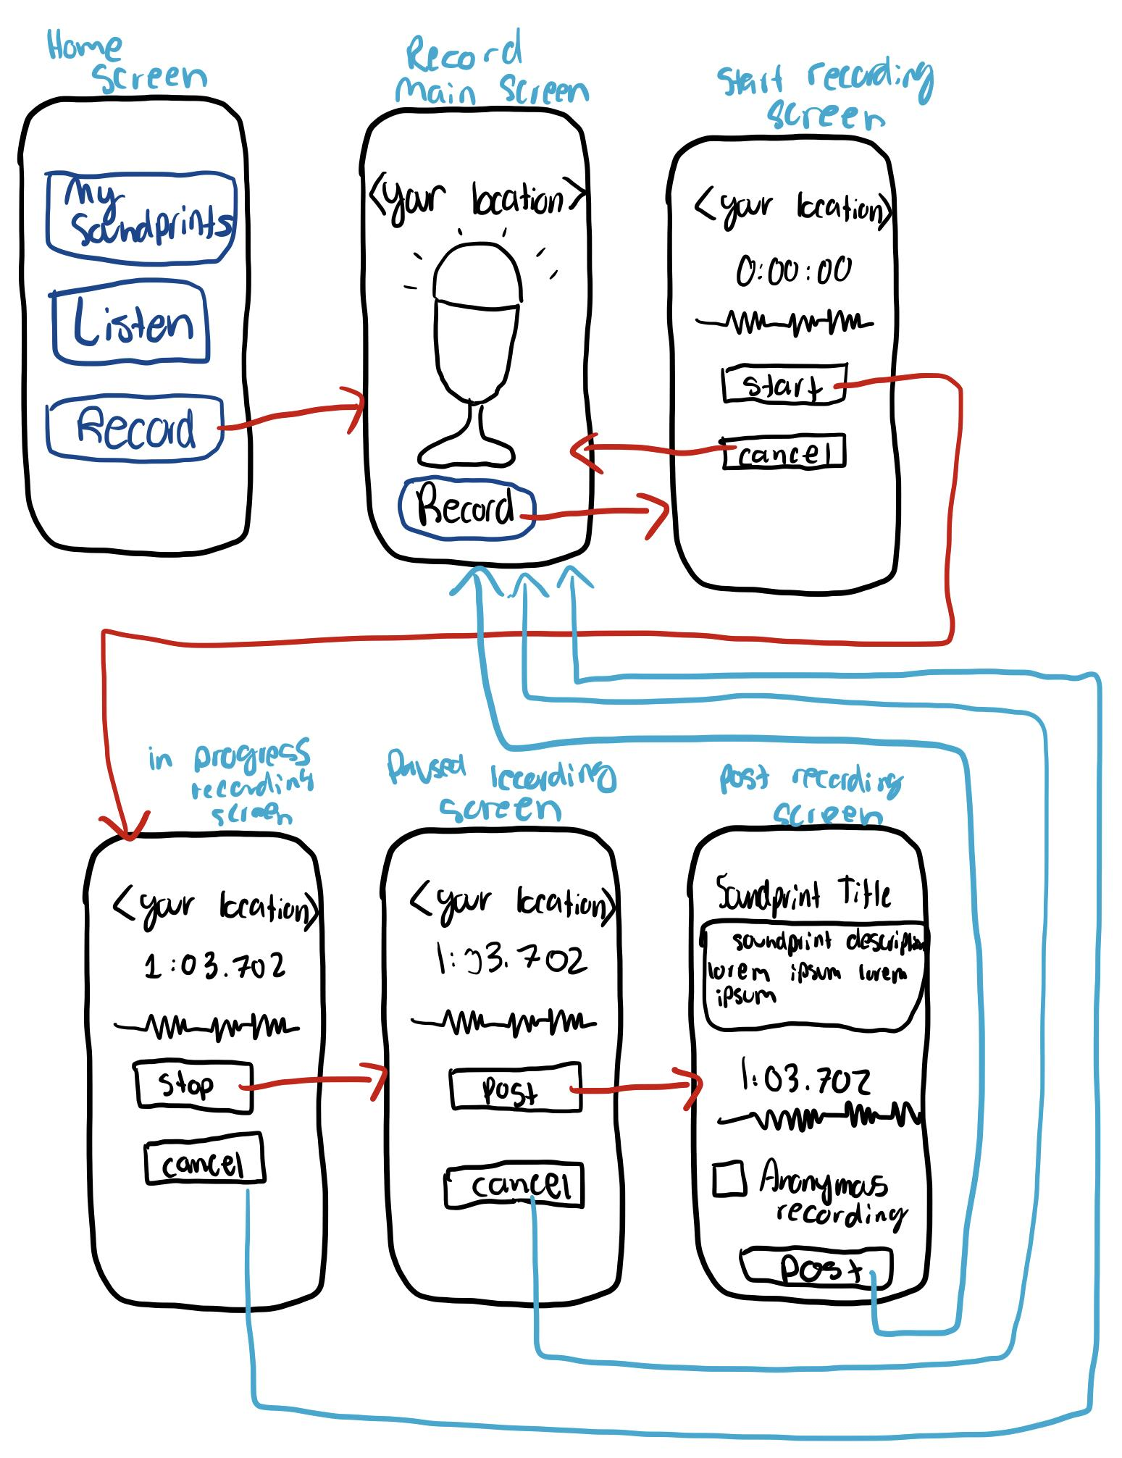
Record Task:
Before

Slide 28
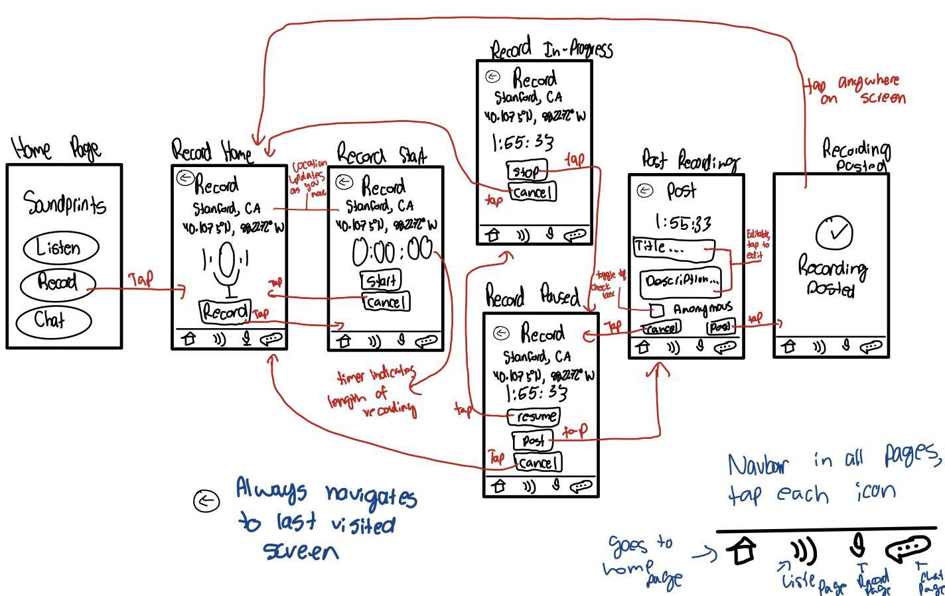
Record Task: After

Slide 29
Major Design Changes: Record
Add a screen confirming the recording was posted
  This allows for a graceful transition, making the experience more pleasant
Add a back button in all screens
  Before, the back button was only present in some screens
  Making the back button available on all screens prevents user confusion
  This addresses our usability goal of increasing robustness
Notes:
Before, the back button was only present in some screens since the back button and home button often allowed you to navigate to the same screen
While we considered removing the back button altogether
However, we decided that keeping the back button would help keep peace of mind of our users
Instead, we make the back button available on all screens, since it prevents user confusion
This addresses our usability goal of increasing robustness

Slide 30
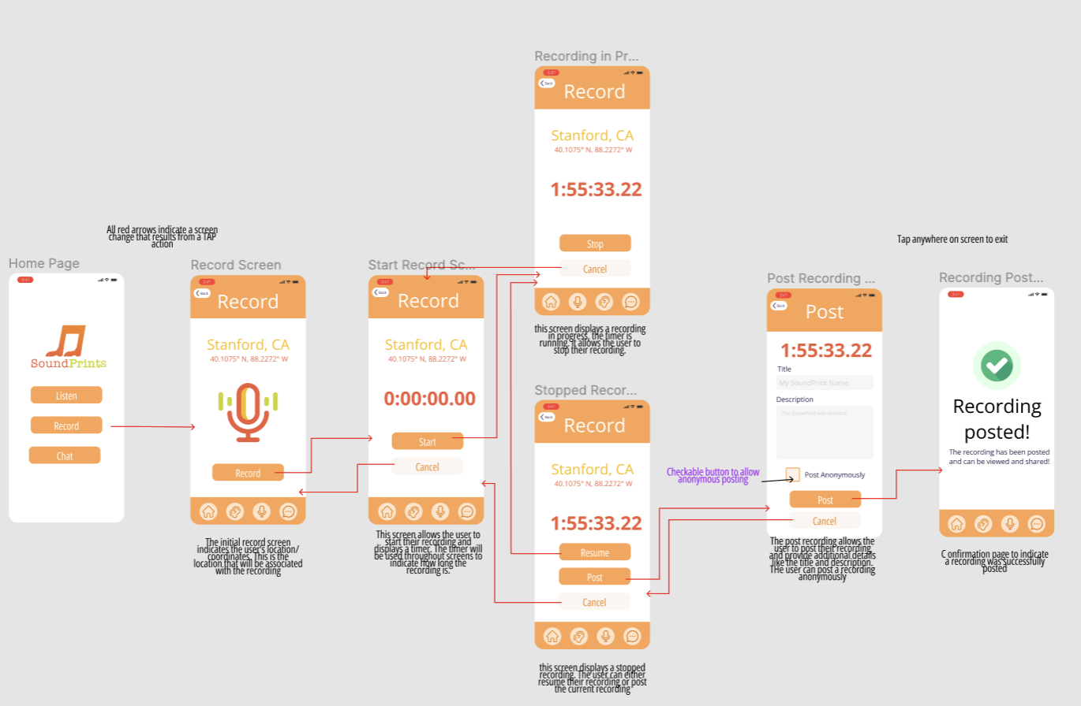
Record Medium
Fidelity
Notes:
View enlarged medfi prototype sing this link: https://www.figma.com/file/wrQpsVX7whXSX19XgMReNB/med-fi?node-id=20%3A2

Slide 31
Share
Share an audio recording that you made with a friend.
Notes:
No change in tasks from our low fidelity prototype.
Listening to recordings made by others is our simple task, because this is the task that requires the lowest effort (plugging in headphones and listening). It is the first step to becoming inspired to achieving one goals. Once users achieve their goals, then we hope that they will make recordings and share those recordings with their friends.

Slide 32
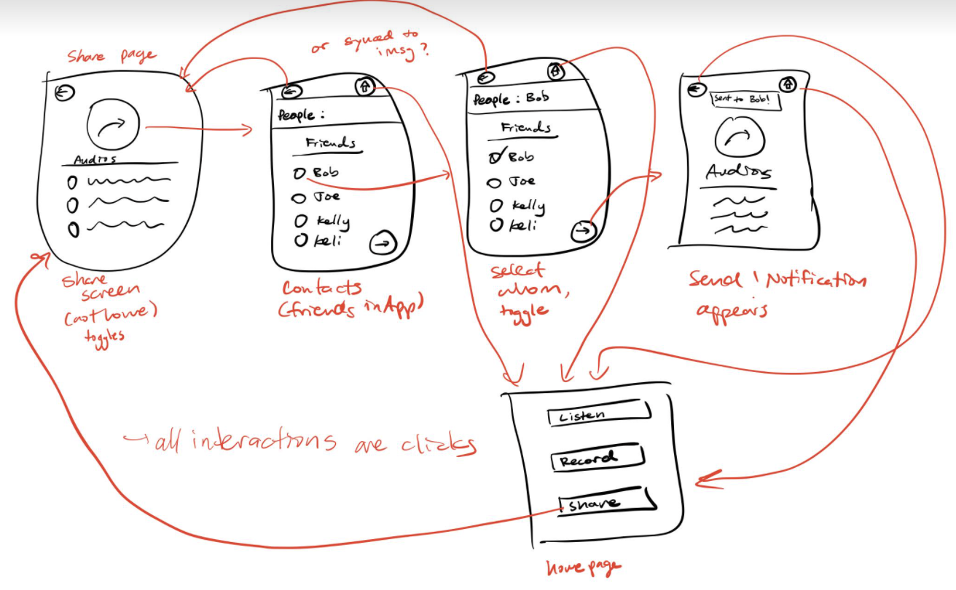
Share, before proto (low fi) sketch

Slide 33
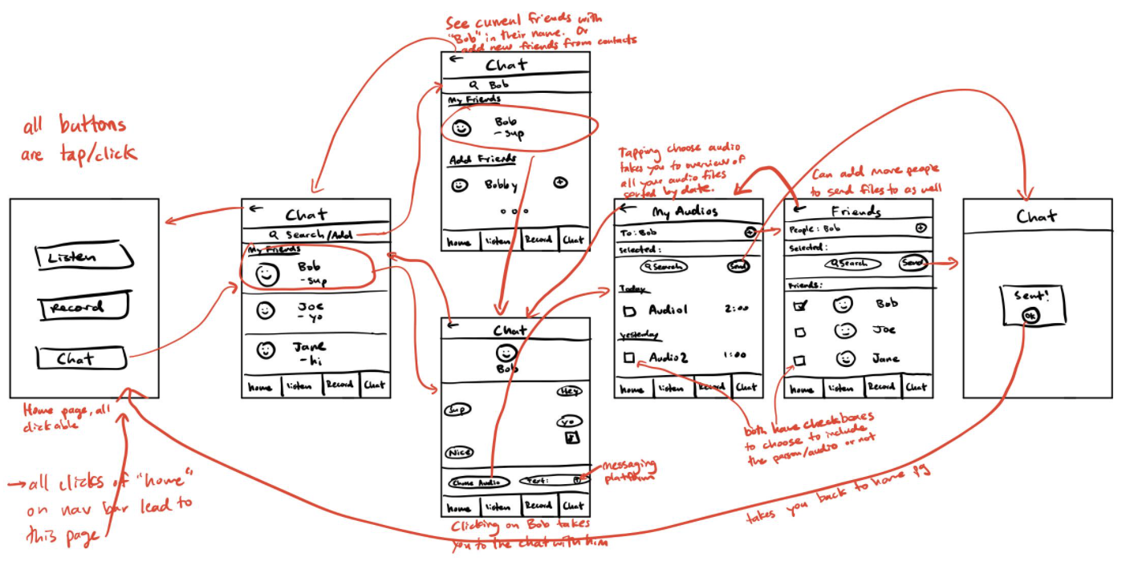
Share, after proto (low fi) sketch

Slide 34
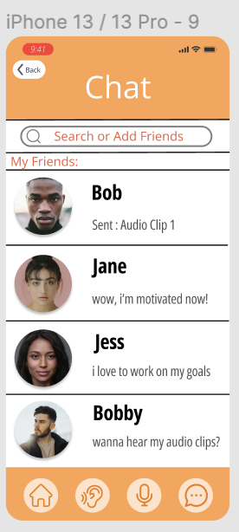
Major Design Changes: Share
“Chat” with friends instead of only sharing recordings
Able to share audio, exchange text messages, and add friends
Able to keep conversations you have with others
Makes user experience more pleasant
Only add friends from contacts list to better promote inclusion and privacy
Notes:
More detailed explanation:
Share to Chat: In our low-fidelity prototype presentation, our classmates mentioned that the share option seemed a little bit limited. One of our encoded values is inclusion and developing community, so we wanted to have a feature where users could stay in contact and connect with new people while still being able to share their audios. We incorporated a chat function so while users can still share their audio messages, they are not limited to this. Our users can now more easily and smoothly communicate with text or audios with their friends and also add new friends. Additionally, the messaging system in SoundPrints lets you revisit old conversations.
We decided to keep our complex task the same (share a recording that you made with a friend) because this is still the core feature of the chat that will help users connect with and inspire their friends.
You can only add friends from your contact list, because this helps us encode our values of inclusion and privacy.

Slide 35
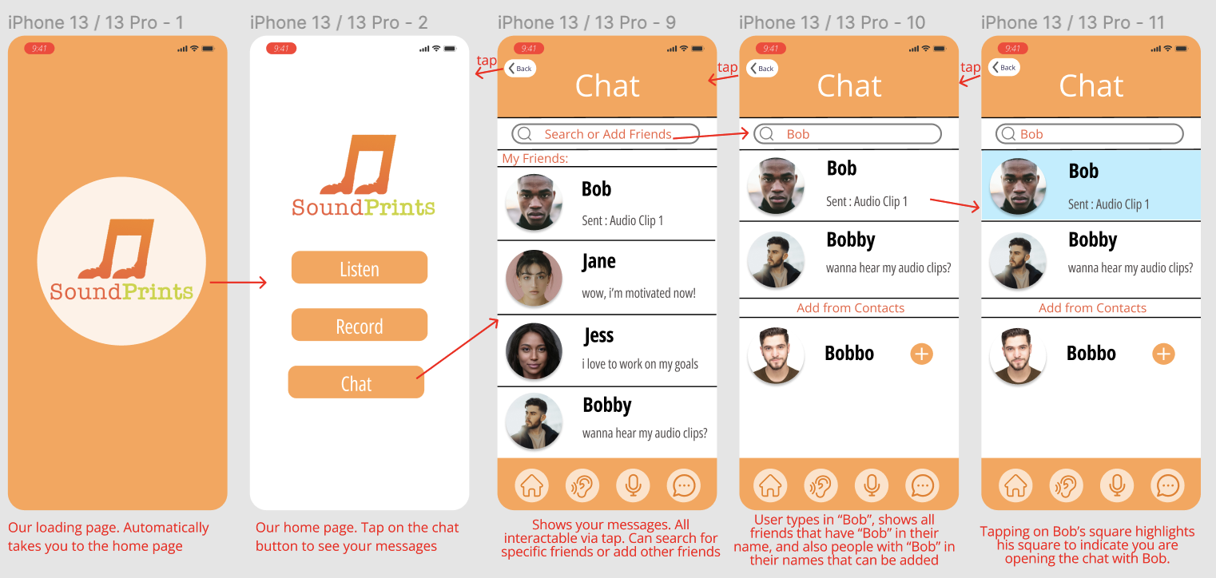
Share Medium Fidelity

Slide 36
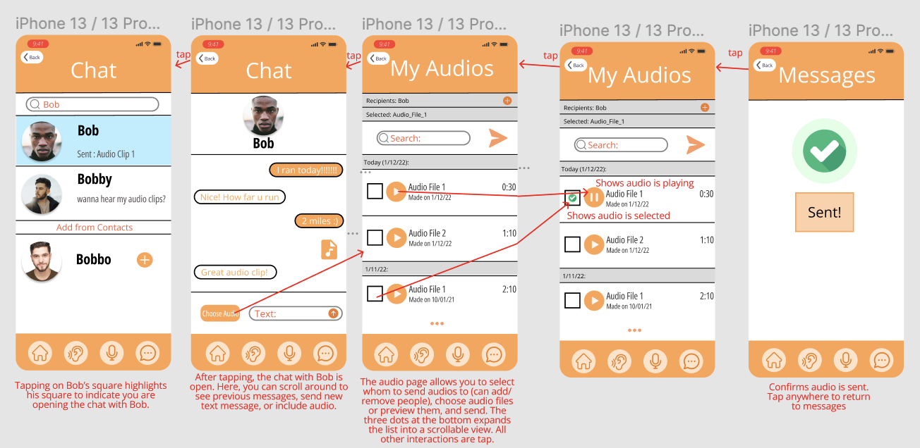
Share Medium Fidelity
Notes:
Link in case trouble reading: https://www.figma.com/file/wrQpsVX7whXSX19XgMReNB/med-fi?node-id=8%3A5

Slide 37
Prototype Overview

Slide 38
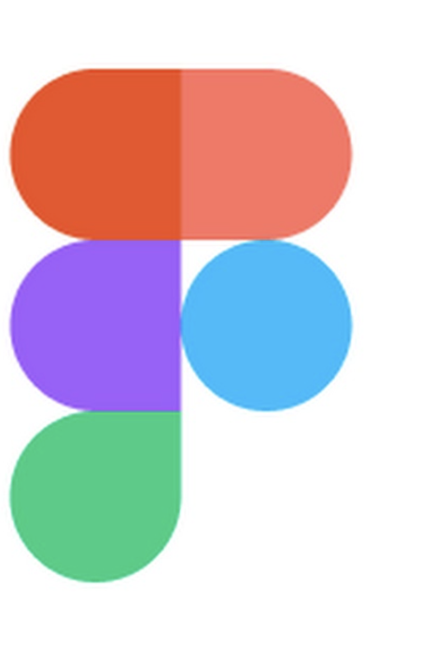
Design/Prototyping Tools
Used in medium-fidelity prototype
Pros:
Collaborative environment
Efficient prototyping
Easy to make duplicate slides
  Experiment slide designs
Cons:
Limited toolkits, had to import
Steep learning curve
Figma

Slide 39

Design/Prototyping Tools
Used in low-fidelity prototype
Pros:
Collaborative environment, Figma was better
Easy to design simple sketches
Cons:
Prototyping was from single screen view (hard to see overview)
Hard to learn, also felt less advanced than Figma
Marvel

Slide 40
Limitations/tradeoffs of the current prototype
Location Real Time Updates
  Our app depends on real time updates based on a user’s location, however Figma doesn’t allow for this feature. Instead, we include location context in our User README
Audio Input Output
  Our app also depends on audio input and output, but Figma doesn’t allow for this either. We hard-coded timestamps and pause/play to indicate audio input/output
Not all buttons are interactive
  Not feasible for prototype
Notes:
We have the following limitations in our prototype:
Location Real Time Updates
Our app depends on real time updates based on a user’s location, however Figma doesn’t allow for this feature. Instead, we include location context in our User README
Audio Input Output
Our app also depends on audio input and output, but Figma doesn’t allow for this either. We hard-coded timestamps and pause/play to indicate audio input/output
Set Map Radius slider bar only has 500 feet and 1 mile as options in the prototype, though actually users should be able to select any radius they want between 5 feet and 1 mile
Users cannot click the audio files to actually hear audio
Users cannot actually add friends when seeing new friends in the search view
A few buttons are not interactive (for example, only one friend in Chat can actually be selected) because making all buttons interactive would take up too much time

Slide 41
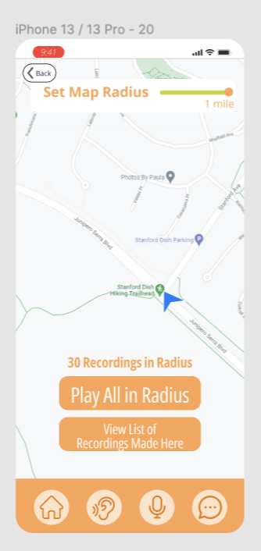
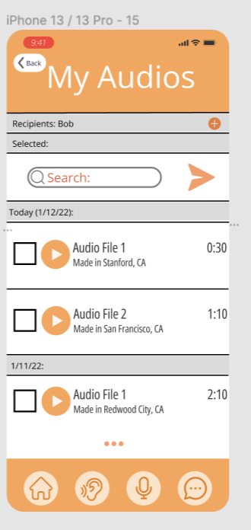
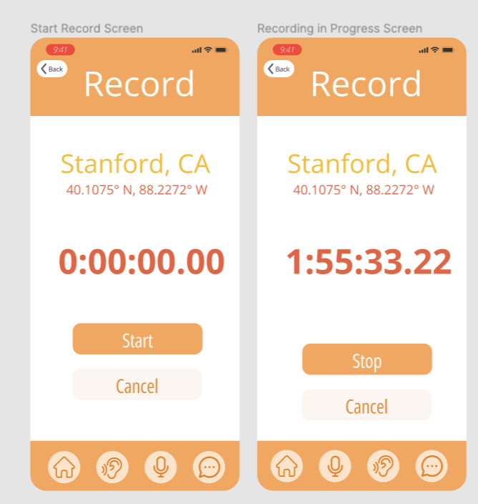
Wizard of Oz Techniques
Location + Hearing the audio
Using Start/Stop to indicate timer
Some button Functionality
Notes:
Button Functionality: Some buttons like the play audio button don’t work, however Wizard of Oz technique could be used to make these buttons functionable and play audio
The design integrates the Wizard of Oz techniques by simulating the functionality of the the real application. For instance, we hard coded many of the buttons so that they still simulate the feeling of changing screens – moving from one section of the application to another. However, we did not have the time to hard code all buttons, so it would require a Wizard of Oz technique to use the buttons that have not been hard code. The listen task has to be Wizard of Oz currently, because when the user hits the play button, there is no sound. An experimenter would have to play some audio recordings for them when they hit this button. Additionally, in order to make a realistic map that accurately uses the user’s real-time location, we would also have to use wizard of Oz to update the map image being shown to correspond to the user’s actual location. Currently the map is hard coded to represent a user walking at the Stanford dish so that users can simulate using the app with a challenging physical activity. The user needs to imagine they are at the dish and walking around while using the prototype. When the user hits “Play All in Radius,” some of the screen frames transition automatically, to give a notification that the user has “exited that radius” and the playlist will reset. It would require greater technical resources than we currently have to implement these features. Real-time location and audio input/output are also unavailable in Figma. Finally, the Record feature also requires Wizard of Oz for the timer to accurately simulate when the user “starts” and “stops” the recording. Currently, we have the timer completely hardcoded.
Additionally, we filled the design with pre-filled text to show how user interactions would normally look. As well, to demonstrate the workflow, we also simulated user-created content to test functionalities without committing to extensive coding and development.

Slide 42
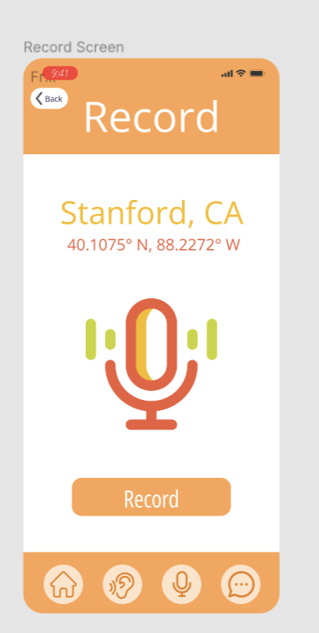
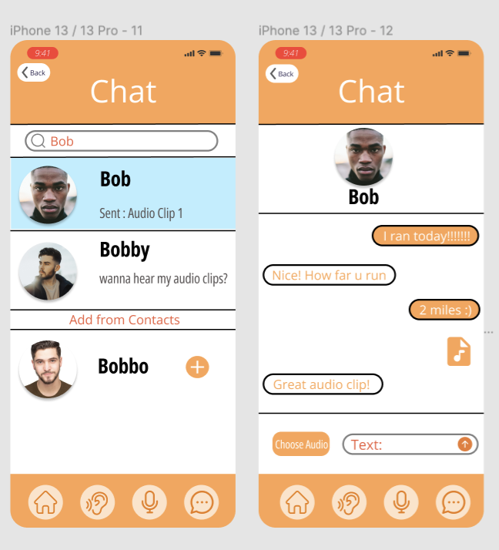
Hard-Coded Features
Chat Contacts &
Messages
Location & Map
Notes:
The design integrates the Wizard of Oz techniques by simulating the functionality of the the real application. For instance, we hard coded many of the buttons so that they still simulate the feeling of changing screens – moving from one section of the application to another. However, we did not have the time to hard code all buttons, so it would require a Wizard of Oz technique to use the buttons that have not been hard code. The listen task has to be Wizard of Oz currently, because when the user hits the play button, there is no sound. An experimenter would have to play some audio recordings for them when they hit this button. Additionally, in order to make a realistic map that accurately uses the user’s real-time location, we would also have to use wizard of Oz to update the map image being shown to correspond to the user’s actual location. Currently the map is hard coded to represent a user walking at the Stanford dish so that users can simulate using the app with a challenging physical activity. The user needs to imagine they are at the dish and walking around while using the prototype. When the user hits “Play All in Radius,” some of the screen frames transition automatically, to give a notification that the user has “exited that radius” and the playlist will reset. It would require greater technical resources than we currently have to implement these features. Real-time location and audio input/output are also unavailable in Figma. Finally, the Record feature also requires Wizard of Oz for the timer to accurately simulate when the user “starts” and “stops” the recording. Currently, we have the timer completely hardcoded.
Additionally, we filled the design with pre-filled text to show how user interactions would normally look. As well, to demonstrate the workflow, we also simulated user-created content to test functionalities without committing to extensive coding and development. Additionally, data, such as user profiles and user messages are hard coded since.

Slide 43
Appendix

Slide 44
